Slide 1
A JSON HTTP Notation for extending application servers with third-party services A case study enabling a virtual file system for the University Cloud Suite
Alessio Giordano
Relatore: prof. Simone Palazzo
Mercoledì, 13 Dicembre 2023

Slide 2
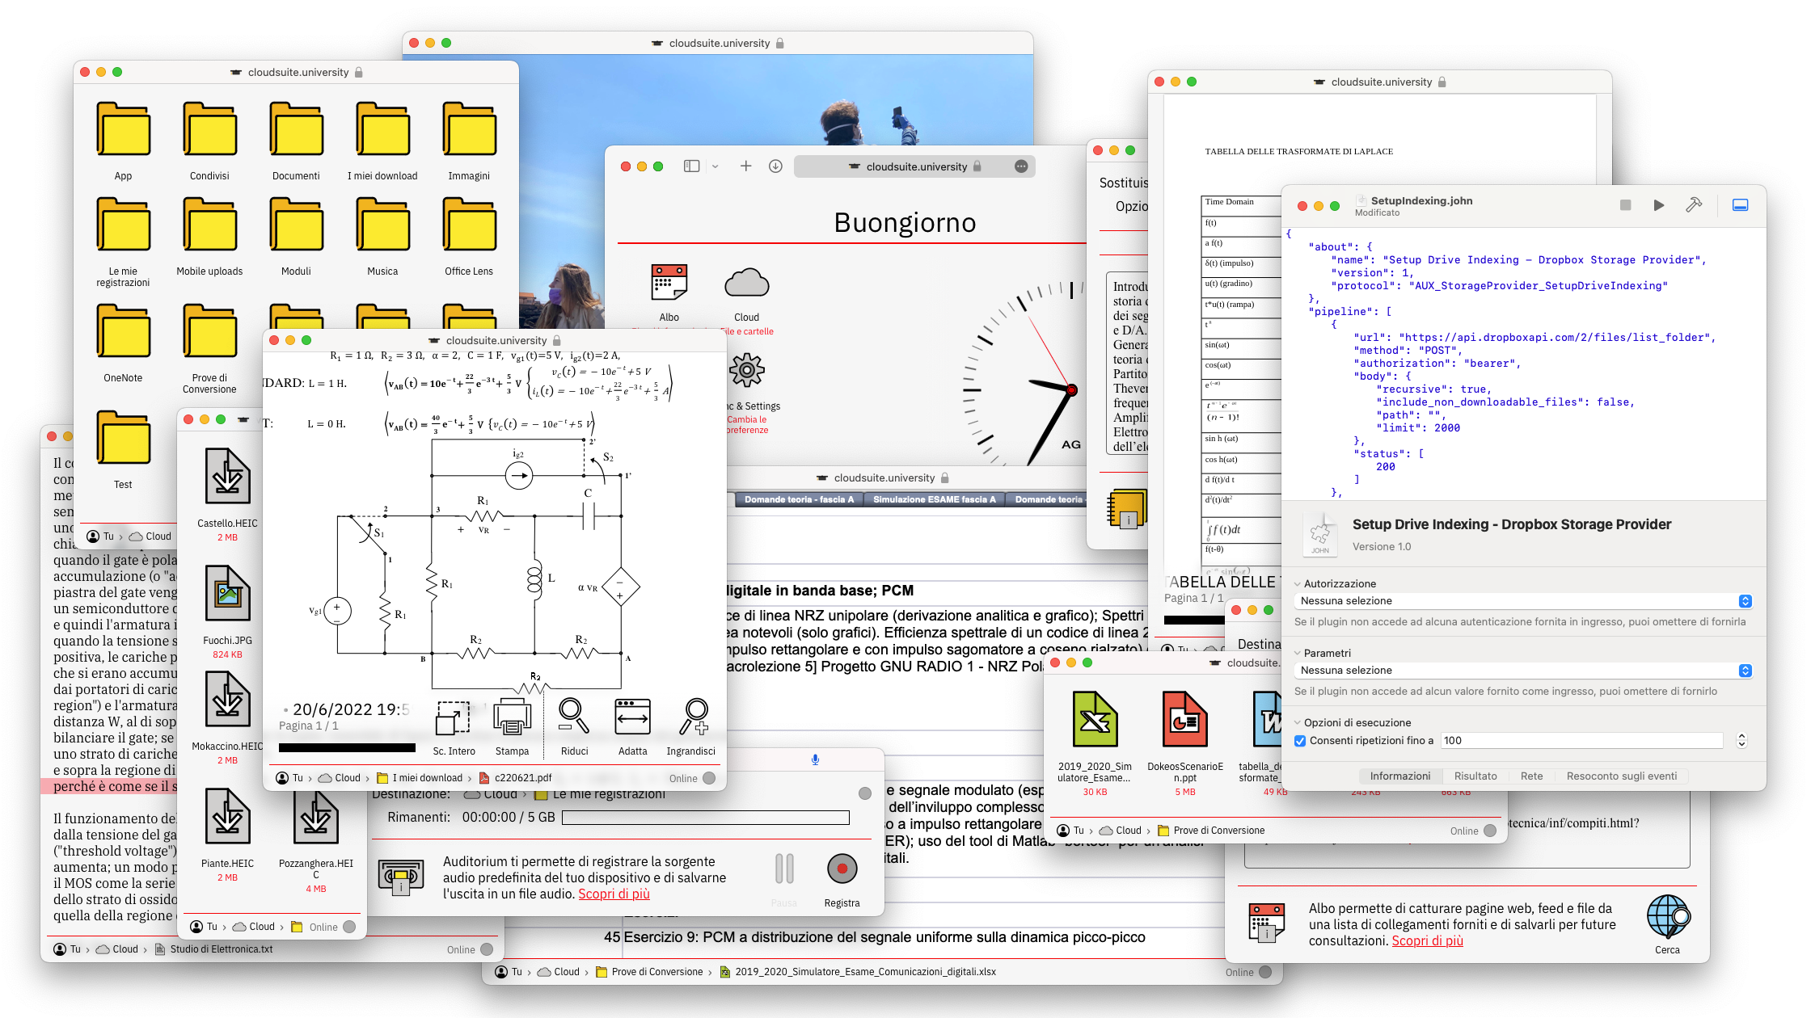
The University Cloud Suite
Obiettivi e Contenuti
The University Cloud Suite

Slide 3
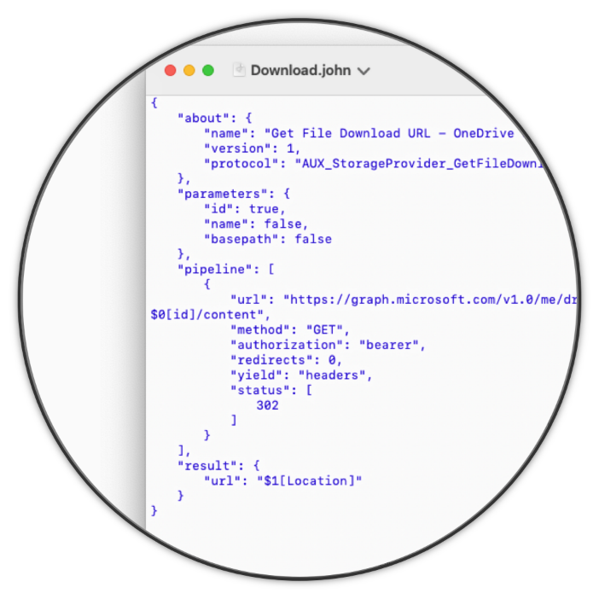
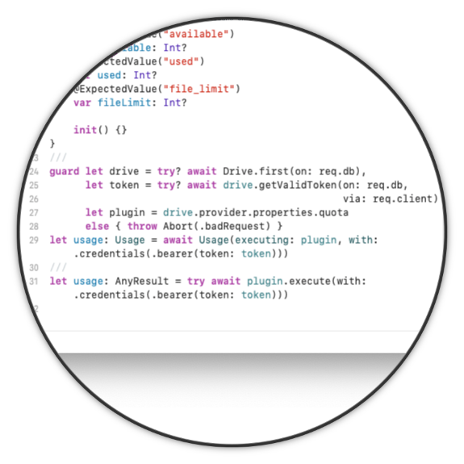
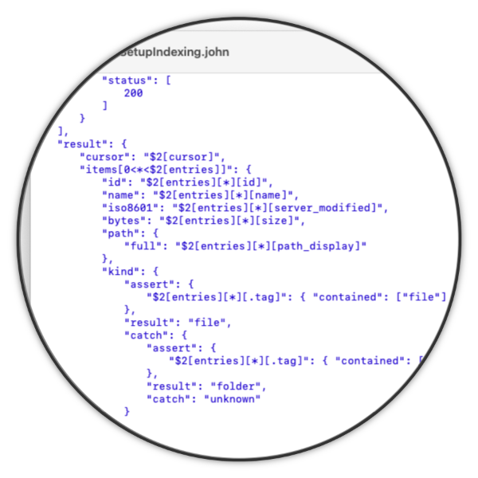



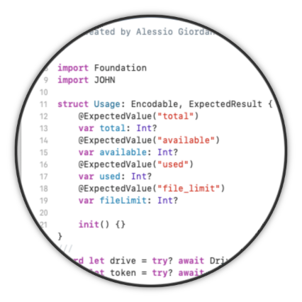
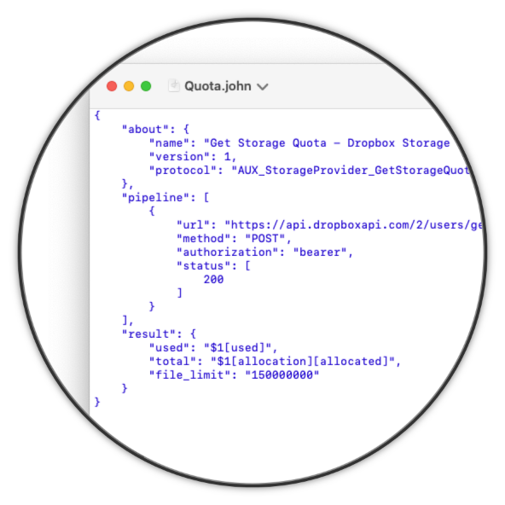
The JSON HTTP Notation
Risultati e Conclusioni
JOHN Language Specification
JOHN Runtime for Swift
JOHN Editor for macOS

